Slide 1

LEARNING OUTCOME 2
Marketing Processes and Planning

Slide 2
LEARNING OUTCOME
Ways in which organisations use elements of the marketing mix to achieve overall business objectives

Slide 3


Key Learning
The 7ps marketing mix
Achieving overall business objectives

Slide 4






The 7Ps marketing mix
The 7Ps marketing mix is a framework used in marketing to describe the key elements that make up a marketing strategy . The 7Ps are:
Product
Price
Place
Promotion
People
Process
Physical evidence
It includes the design, features, packaging, and branding of the product or service
It includes pricing strategies such as discounts, promotions, and pricing tiers
It includes factors such as physical stores, online marketplaces, and shipping options
This refers to the methods used to promote a product or service, such as advertising, public relations, and sales
Employees who are involved in the delivery of the product or service, including their training and expertise
Steps involved in the delivery of the product or service, including order processing, delivery, and customer service
Customers interact with when they use a product or service, such as the packaging, store design, and website layout.

Slide 5
Product Portfolios Analysis
Product portfolio analysis is a technique used by companies to evaluate their range of products or services and identify the strategic direction for each product or service. It involves assessing each product or service in terms of its market position, growth potential, and profitability
3. Product life cycle (PLC) model
1. Boston Consulting Group (BCG) matrix
This model assesses products based on their stage in the product life cycle, which includes introduction, growth, maturity, and decline.
This model assesses products based on their market growth rate and market share. Products are divided into four categories: stars, cash cows, question marks, and dogs.
2. General Electric (GE) matrix
This model assesses products based on their market attractiveness and competitive position. Products are divided into nine categories based on their score on the two factors

Slide 6
Reviewing Pricing Models
When reviewing pricing models in view of established price points and sensitivity to competitors’ pricing and consumers, it is important to consider several factors to ensure that the pricing strategy is effective and sustainable
Market research
01
Conducting market research is essential to understand consumer preferences, behaviour, and perceptions towards pricing.
Market research
Competitive analysis
02
Analyzing competitors’ pricing strategies is crucial to determine the level of competition and market positioning. Understanding the pricing of competing products or services can help identify opportunities to differentiate and create value for consumers
Competitive analysis
Cost analysis
03
Conducting a thorough cost analysis is important to ensure that the pricing strategy is sustainable and profitable. This includes identifying fixed and variable costs, and determining the break-even point for each product or service.
Cost analysis
Value proposition
04
Value proposition
The pricing strategy should be aligned with the value proposition offered to consumers. This includes considering the benefits and features of the product or service, and the perceived value by the target market.

Slide 7
Place strategies and channel distribution
Place strategies and channel distribution are critical components of a company's marketing mix that help expand access and reach to specific market segments
01
Direct sales
E-commerce
Companies can use direct sales channels, such as online or physical stores, to reach customers directly. This approach can help companies build strong relationships with their customers and provide a personalized experience
03
Companies can use e-commerce platforms to expand their reach and access new markets. E-commerce can offer a convenient and accessible way for customers to purchase products or services, and companies can leverage online marketing tools to attract customers
02
Indirect sales
Companies can use intermediaries, such as wholesalers, distributors, and retailers, to reach customers indirectly. This approach can help companies expand their distribution reach and reduce costs
04
Partnerships and collaborations
Companies can partner with other businesses or organizations to expand their reach and access new markets. This approach can help companies leverage the existing customer base and expertise of their partners to reach new audiences

Slide 8
Promotion to stay ahead
Promotion is an essential aspect of any business that seeks to stay ahead of the competition. To achieve this, it's important to use an integrated communication mix that involves cross-communication solutions and digital promotional tools and strategies.
Integrated communication mix
Cross-communication
Digital promotional tools
Refers to the use of various communication channels to reach a wider audience. These channels may include advertising, public relations, personal selling, sales promotion, and direct marketing. By using an
integrated communication mix, businesses can communicate their message to their target audience effectively.
Cross-communication solutions involve the integration of different communication channels to create a consistent message across all platforms. For instance, a business may use social media, email marketing, and website content to communicate the same message to its target audience.
Digital promotional tools and strategies are an essential part of modern marketing. These tools and strategies include search engine optimization (SEO), pay-per-click (PPC) advertising, social media marketing, influencer marketing, email marketing, and content marketing. By using these digital promotional tools and strategies, businesses can reach a wider audience and engage with their customers in a more personalized way

Slide 9
The different roles of ‘People’ in marketing
These are the people who directly interact with customers, such as sales representatives, customer service representatives, and account managers. They are responsible for understanding customer needs and delivering solutions that meet those needs. They may also be involved in the process of building relationships with customers and maintaining customer loyalty.
1
Customer interfacing personnel
These are the people who provide support to customer interfacing personnel, such as marketing analysts, data analysts, and marketing operations specialists. They may be responsible for collecting and analyzing data to inform marketing strategies, providing technical support for marketing campaigns, and ensuring that marketing initiatives are executed effectively.
2
Support personnel
These are the people who are responsible for developing and improving products and services that meet customer needs. They may work closely with customer interfacing personnel to understand customer needs and preferences and translate those insights into product and service features
3
Product development personnel

Slide 10
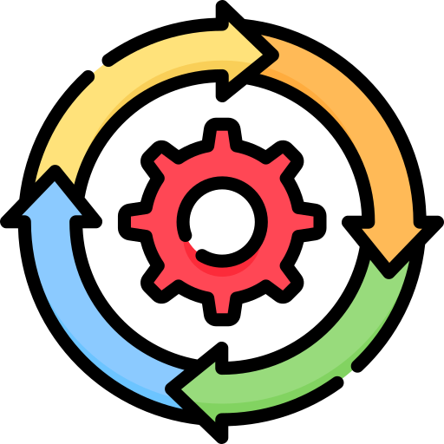
The different types of Processes used to expedite the marketing function
Delivering a consistent service is critical to the success of any business, and marketing is no exception. To achieve this, companies must implement efficient systems and processes that ensure consistent quality and delivery of marketing activities. Here are some examples of systems and processes used to expedite the marketing function:
Marketing automation: Marketing automation refers to the use of software tools to automate repetitive marketing tasks, such as email campaigns, social media posting, and lead scoring. By automating these processes, marketers can save time and ensure consistent delivery of marketing messages.
Content management: Content management systems (CMS) are used to manage and organize digital content, such as blog posts, articles, and videos. By using a CMS, marketers can ensure that content is consistently branded, formatted, and optimized for search engines.
Customer relationship management (CRM): CRM systems are used to manage customer interactions and data, including contact information, purchase history, and communication preferences. By using a CRM, marketers can personalize marketing messages and track customer behaviour to improve targeting and engagement.

Slide 11
Physical Evidence
In marketing, physical evidence refers to the tangible elements that customers can see, touch, or experience when interacting with a company. Physical evidence can include the company's facilities, equipment, uniforms, signage, packaging, and other tangible objects that help to shape the customer's perception of the company

Slide 12
Physical Evidence In Different Industries
The physical store layout, decor, lighting, and music can all contribute to the customer's experience. The quality of the merchandise, the product displays, and the cleanliness of the store are also important physical evidence elements
Retail stores
The hotel lobby, rooms, furnishings, and amenities are all examples of physical evidence that can shape the customer's perception of the hotel. The quality of the food and beverages, the cleanliness of the facilities, and the friendliness of the staff are also important physical evidence elements.
Hotels
The restaurant decor, table settings, and menu design can all contribute to the customer's experience. The quality of the food, the presentation of the dishes, and the cleanliness of the restaurant are also important physical evidence elements
Restaurants

Slide 13
Achieving overall business objectives involves setting clear goals, creating a strategic plan, and executing that plan effectively
Achieving overall business objectives

Slide 14
Some steps that can help a business achieve its objectives
Define clear goals: A business must set specific, measurable, achievable, relevant, and time-bound (SMART) goals that align with its overall vision and mission. This will provide a clear direction and focus for the business.
2.Create a strategic plan: Develop a comprehensive plan that outlines the steps needed to achieve the business goals. This plan should include a detailed analysis of the business's strengths, weaknesses, opportunities, and threats (SWOT), as well as a plan for how to address each of these factors.
3.Implement the plan: Execute the plan effectively by delegating tasks, setting timelines, and monitoring progress regularly.

Slide 15

Marketing mix tactics for building and maintaining stakeholder relationships, penetrating markets, expanding reach to new market segments and developing new products
The marketing mix is a set of tools and tactics that businesses use to promote their products or services to customers. The 4 Ps of the marketing mix are product, price, place, and promotion.
some ways businesses can use the marketing mix to build and maintain stakeholder relationships, penetrate new markets, expand their reach to new market segments, and develop new products
1.Product: Developing new products or modifying existing ones can be a great way to reach new market segments and build stakeholder relationships. This involves researching and analyzing customer needs and preferences, and creating products that meet those needs. Additionally, businesses can focus on improving the quality, features, and benefits of existing products to maintain customer loyalty and satisfaction
2.Price: Pricing strategies can also be used to penetrate new markets and build stakeholder relationships. For example, businesses can offer discounts, promotions, or loyalty programs to attract new customers or retain existing ones. They can also adjust their pricing strategy to be more competitive in new markets.

Slide 16
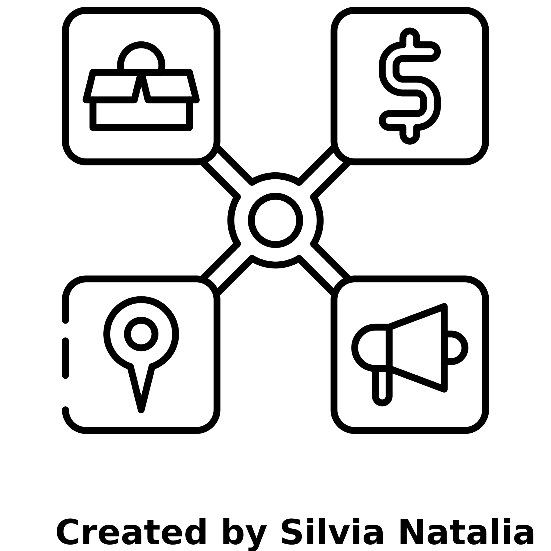
3.Place: Place refers to the distribution channels used to make products or services available to customers. Businesses can use this element of the marketing mix to reach new markets and build stakeholder relationships by expanding their distribution channels. For example, they can offer their products or services through online channels or through partnerships with other businesses.
4.Promotion: Promotion includes all the activities used to communicate the value of a product or service to customers. Businesses can use promotion to build stakeholder relationships by developing and executing targeted advertising campaigns, sponsoring events, or engaging in public relations activities. Additionally, they can use promotion to penetrate new markets by targeting customers in different geographic regions or demographic segments.

Slide 17
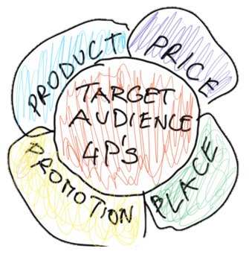
Adapting and integrating the marketing mix to meet organisational objectives and changes in a competitive environment
The marketing mix is a flexible framework that businesses can adapt and integrate to meet their organizational objectives and respond to changes in the competitive environment. Here are some ways businesses can adapt and integrate the marketing mix to achieve their goals:
Identify organizational objectives:
The first step in adapting the marketing mix is to identify the organizational objectives. This involves setting clear, specific, and measurable goals, such as increasing sales, improving customer satisfaction, or entering new markets.
2.Analyze the competitive environment:
Businesses must also analyze the competitive environment to identify opportunities and threats. This involves researching competitors, market trends, and consumer behaviour to identify gaps and areas for improvement.
3.Evaluate the marketing mix:
Once the organizational objectives and competitive environment have been identified, businesses can evaluate their existing marketing mix to identify strengths and weaknesses. This involves assessing the 4 Ps of the marketing mix and determining how they can be adapted or integrated to achieve the organizational objectives.

Slide 18

Measuring the effectiveness of the marketing mix using metrics
The marketing mix is a combination of various elements such as product, price, promotion, and place (distribution) that a company uses to promote its products or services in the market. Measuring the effectiveness of the marketing mix is crucial for a company to evaluate the success of its marketing efforts and to make adjustments as necessary.

Slide 19
Examples:
Market share: This metric measures the percentage of total sales in the market that a company has. A company with a high market share is more dominant in the market than its competitors.
Sales: This metric measures the total revenue generated by a company's products or services. An increase in sales indicates that the marketing mix is effective in promoting the company's offerings.
Number of new products: This metric measures the number of new products or services introduced by the company. A high number of new products indicates that the company is continuously innovating and meeting the changing needs of the market.
Repeat purchases: This metric measures the percentage of customers who make a repeat purchase of the company's products or services. A high percentage of repeat purchases indicates that the company's offerings are satisfying the needs of its customers

Slide 20

Summary
Organizations use different elements of the marketing mix to achieve overall business objectives. The marketing mix comprises product, price, promotion, and place (distribution).
1.Product: An organization can achieve its overall business objectives by offering products that meet the needs and wants of its target market. This involves developing products that are of high quality, unique, and provide value to customers.
2.Price: An organization can use pricing strategies to achieve its overall business objectives. This involves setting prices that are competitive, profitable, and appropriate for the target market. The pricing strategy adopted can be based on cost, value, or competition.
3.Promotion: An organization can use promotion to achieve its overall business objectives by creating awareness, interest, desire, and action among its target market. This involves using different communication channels such as advertising, personal selling, public relations, and sales promotion.
4.Place (distribution): An organization can use distribution channels to achieve its overall business objectives by making its products easily accessible to its target market. This involves selecting distribution channels that are efficient, effective, and suitable for the target market.

Slide 21
THANK YOU

